Slide 1


Final Project Unsupervised Machine Learning: Dry Bean Dataset
IBM Machine Learning Professional Certificate
Course 04: Unsupervised Machine Learning | Dry Bean Dataset

Slide 2
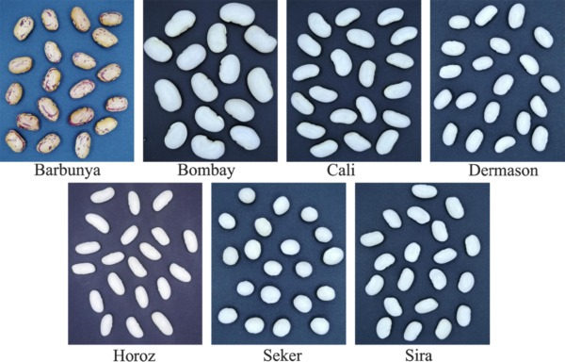
Contents
Dataset Description
Main objectives of the analysis.
EDA, Data Cleaning, Feature Engineering
Applying Clustering Algorithms.
Machine learning analysis and findings.
Models flaws and advanced steps.

Slide 3
Data Description Section

Slide 4
Introduction
ML Algorithms play an essential and promising role in agricultural sector, from this point will discover in this report how we can implement unsupervised learning specifically clustering algorithms to a dataset has Images of 13,611 grains of 7 different registered dry beans were taken with a high-resolution camera. A total of 16 features; 12 dimensions and 4 shape forms, were obtained from the grains.

Slide 5
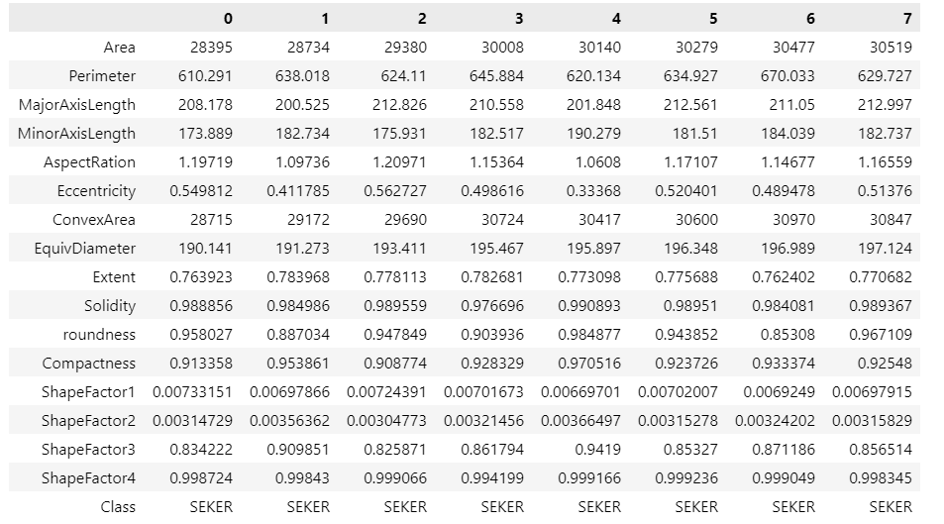
Dataset Description Features Explanations 01
Dataset Dimensions:
(rows, columns) | (13611, 17)
We have 16 features in dry bean dataset in addition of the targeted variable “Class” will explain each of these features in the next slides!

Slide 6
Dataset Description Features Explanations 02
1.) Area (A): The area of a bean zone and the number of pixels within its boundaries.
2.) Perimeter (P): Bean circumference is defined as the length of its border.
3.) Major axis length (L): The distance between the ends of the longest line that can be drawn from a bean.
4.) Minor axis length (l): The longest line that can be drawn from the bean while standing perpendicular to the main axis.
5.) Aspect ratio (K): Defines the relationship between L and l.
6.) Eccentricity (Ec): Eccentricity of the ellipse having the same moments as the region.
7.) Convex area (C): Number of pixels in the smallest convex polygon that can contain the area of a bean seed.
8.) Equivalent diameter (Ed): The diameter of a circle having the same area as a bean seed area.
9.) Extent (Ex): The ratio of the pixels in the bounding box to the bean area.
10.) Solidity (S): Also known as convexity. The ratio of the pixels in the convex shell to those found in beans.

Slide 7
Dataset Description Features Explanations 03
We have 7 different classes of beans. So, when we apply clustering methods, we expect to find the same number of Clusters! using clustering algorithms.
12.) Compactness (CO): Measures the roundness of an object: Ed/L
13.) ShapeFactor1 (SF1)
14.) ShapeFactor2 (SF2)
15.) ShapeFactor3 (SF3)
16.) ShapeFactor4 (SF4)
17.) Class: (Barbunya, Bombay, Cali, Dermosan, Horoz, Seker and Sira)

Slide 8
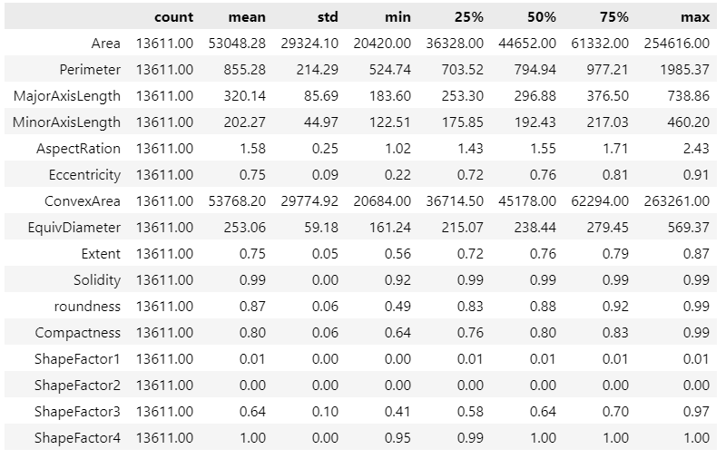
Dataset Description
Features statistical description

Slide 9
Main Objective of the analysis:
In this section we will explore the dataset in-depth through several EDA techniques such as checking null values, data skewness, and data visualization, furthermore, showing the correlation between the features for the sake of feature engineering implementation and data cleaning.

Slide 10
Exploratory Data Analysis (EDA) + Feature Engineering Section

Slide 11
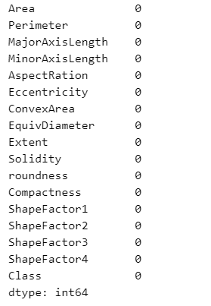

Exploratory Data Analysis
Checking for Null values
Great, no missing values within our features !

Slide 12
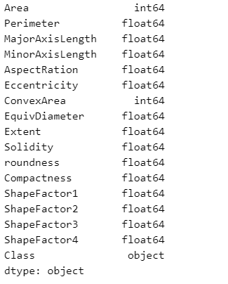
Exploratory Data Analysis
- Identifying categorical features and numerical features:
Integers + Float
(Numerical Features)
Categorical Features

Slide 13
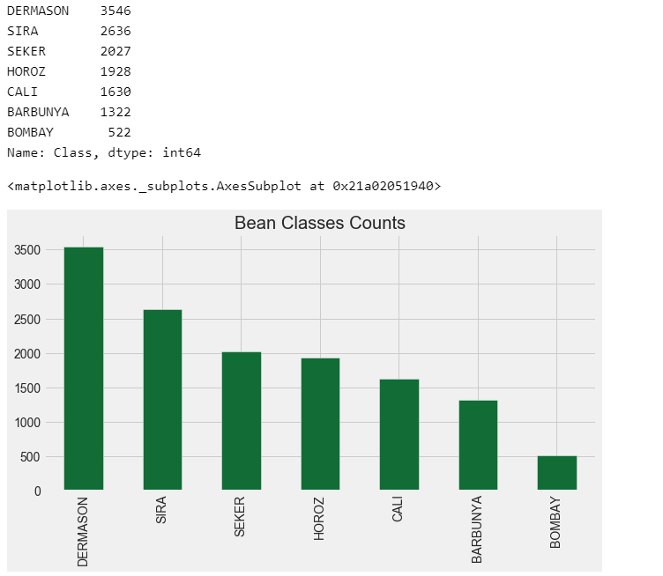
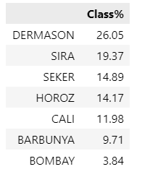
Exploratory Data Analysis
Exploring the target variable :
As shown, we have unbalanced bean dataset, since there are less observations for some classes as BARBUNYA and BOMBAY, in this presentation we will discover if this could affect the clustering process.

Slide 14
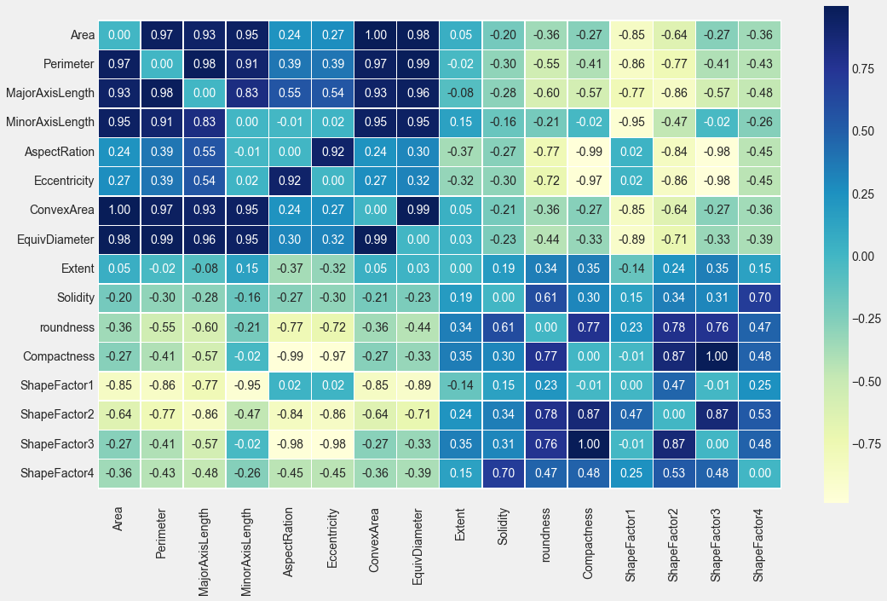
Exploratory Data Analysis
- Studying the correlations between features using Heat Map!
The goal of this matrix is to show the correlations between features, and this is useful for feature engineering techniques in the coming slides will show these correlations more clearly through data frames.

Slide 15
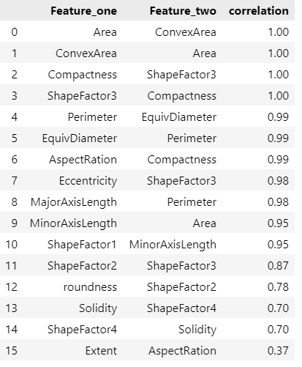
Exploratory Data Analysis
- Studying the highest correlations between the features
We can notice that there is high correlation between the features because most of them are geometric features describe the shape of the bean.

Slide 16

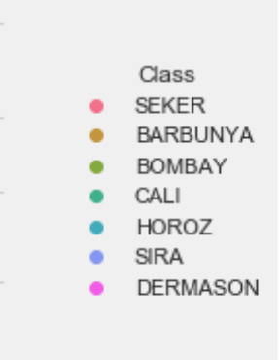
Exploratory Data Analysis
Pair plot
Using pair plot we can obtain the linearity between the features in addition of that we can see how beans classes are distributed to form the clusters.

Slide 17
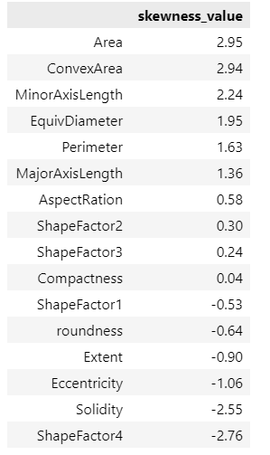
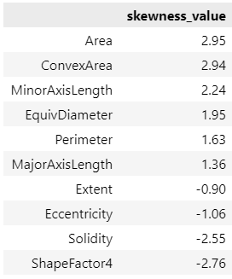
Exploratory Data Analysis
Skewness examination in the dataset
All features
Skewness examination in the features in anticipation of transformations.
We take in our consideration the following:
(nearly 0) or (-0.75 < value < 0.75) no skewness
Positive (value > +0.75): right skewness
negative (value <-0.75): left skewness
Feature should be transformed

Slide 18
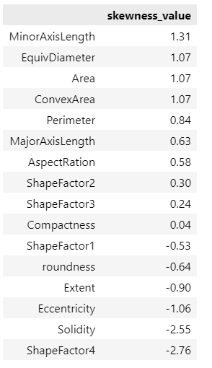
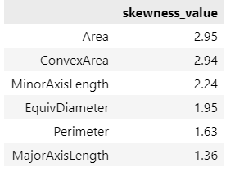
Feature Engineering
Applying Log transformation to right skewed data.
Note: when we apply log transformation on the features, only positive skewness will be handled since log transformation tries to approach right skewness into left skewness to reach out the symmetric or normal distribution.
Log Transformation

Slide 19
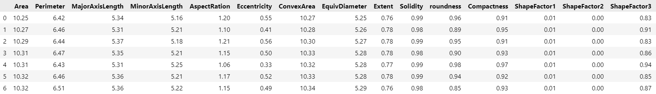
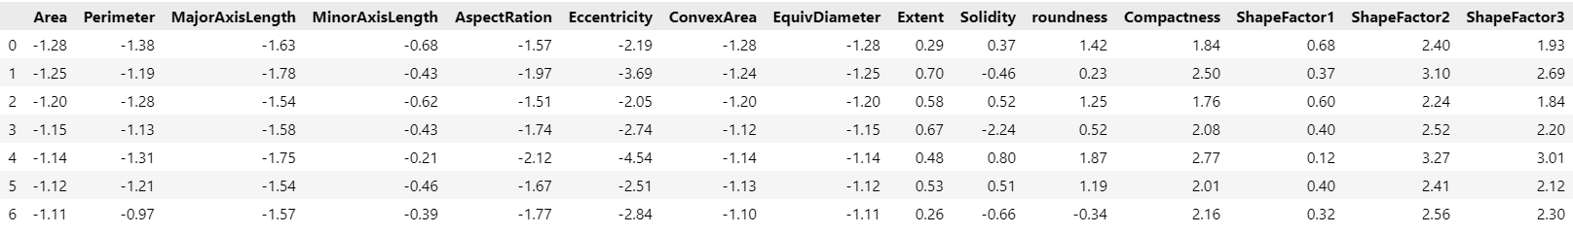
Feature Engineering
Features Scaling
Feature scaling is relevant in machine learning models that compute some sort of distance metric, where we are going to use clustering methods like K-means which depends on distance metric we must scale our features to perform clustering in the appropriate way!

Slide 20
Machine Learning Analysis & Findings

Slide 21
Machine Learning Analysis & Findings
In the following slides we will compare between 4 different Clustering methods k-means, Agglomerative Hierarchical clustering, DBSCAN, MeanShift in terms of finding the appropriate number of clusters and comparing the clustered observations with the actual classes in the dry bean dataset.

Slide 22
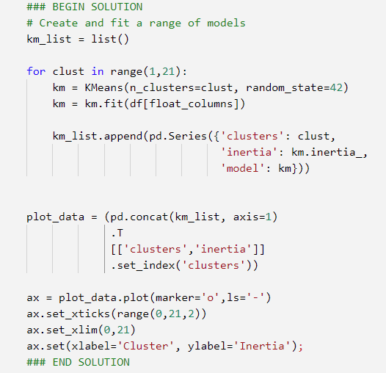
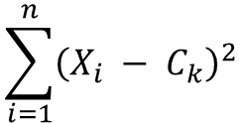
Machine Learning Analysis K-means Algorithm 01
Here we have Implemented K-means algorithm, with a range of different K values (0 – 20) for the sake of finding the appropriate number of clusters in dry bean dataset, and to measure the entropy in the model we’ve selected the inertia metric and elbow method to find the appropriate value of K (no. clusters)
𝐈𝐧𝐞𝐫𝐭𝐢𝐚 : is defined as the sum of squared distance from each point (Xi) to its cluster Ck
$$\sum_{i=1}^{n}{{\left(X_{i} − C_{k}\right)}^{2}}$$

Slide 23
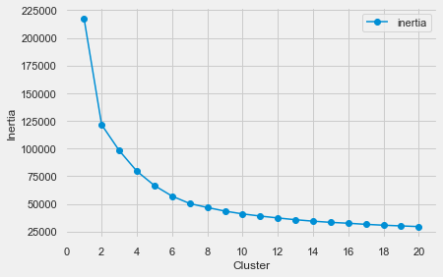
Machine Learning Analysis K-means Algorithm 02
As shown in the graph, in case we follow elbow
method approach we can clearly obtain that the
appropriate number of clusters ranges between 6 – 8 where, this is aligned with our dataset which contains seven different clusters (Classes)

Slide 24
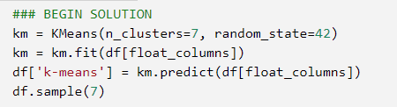
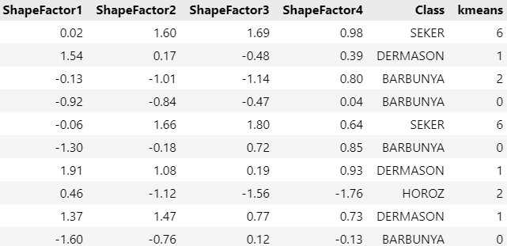
Machine Learning Analysis K-means Algorithm 03
Applying K-means with no. clusters = 7
After applying K-means algorithm with no. clusters = 7 to the dry bean dataset, it will classify each observation to the 7 clusters which we assigned in the model then we will see how many of these observations are classified correctly.
Class Label | Cluster Number
BARBUNYA | 0
DERMASON | 1
HORZO | 2
Cali | 3
BOMBAY | 4
SIRA | 5
SEKER | 6

Slide 25
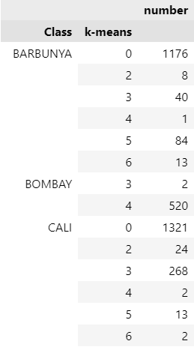
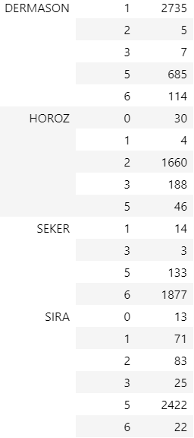
Machine Learning Analysis K-means Algorithm 04
Here we group by Class and k-means columns to validate our clustering model with the actual classes labeling:
Cluster index | Class Label | Correct : all | Correct Clustering percentage
0 | BARBUNYA | 1176 : 1322 | 88.96 %
1 | DERMASON | 2735 : 3546 | 77.13 %
2 | HORZO | 1660 : 1928 | 86.10 %
3 | CALI | 268 : 1630 | 16.44 %
4 | BOMBAY | 520 : 522 | 99.17 %
5 | SIRA | 2422 : 2636 | 91.88 %
6 | SEKER | 1877 : 2027 | 92.60 %
The outcomes were very good and satisfactory for 5 clusters, , but only one of the clusters (CALI) achieved poor results because of characteristics similarity with another cluster (BARBUNYA)

Slide 26
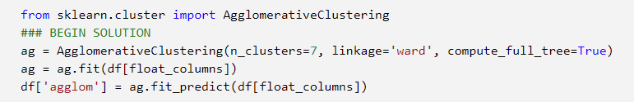
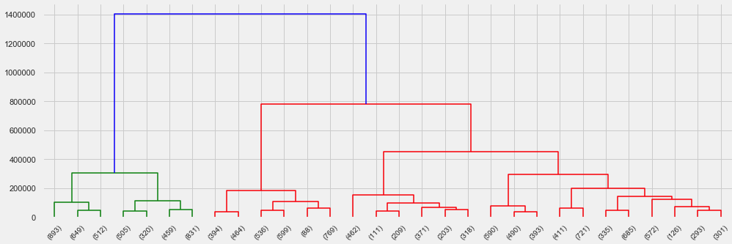
Machine Learning Analysis Agglomerative Clustering Algorithm 01
Applying agglomerative hierarchical clustering with no. clusters = 7
Class Label | Cluster Number
BARBUNYA | 0
HORZO | 1
SIRA | 2
SEKER | 3
BOMBAY | 4
DERMASON | 5
CALI | 6

Slide 27
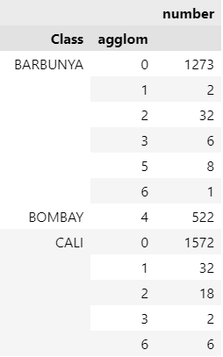
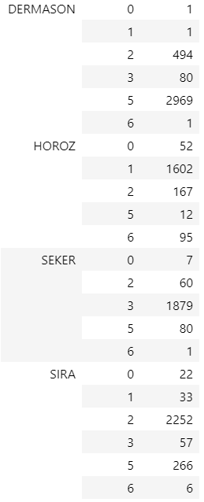
Machine Learning Analysis Agglomerative Clustering Algorithm 02
Here we group by Class and agglom columns to validate our clustering model with the actual classes labeling:
Cluster index | Class Label | Correct : all | Correct Clustering percentage
0 | BARBUNYA | 1273 : 1322 | 96.30 %
5 | DERMASON | 2969 : 3546 | 83.73 %
1 | HORZO | 1602 : 1928 | 83.09 %
6 | CALI | 6 : 1630 | 0.37 %
4 | BOMBAY | 522 : 522 | 100 %
2 | SIRA | 2252 : 2636 | 85.43 %
3 | SEKER | 1879 : 2027 | 92.70 %
Again (CALI) Cluster achieved very poor results because of characteristics similarity (BARBUNYA) cluster

Slide 28
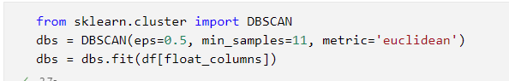
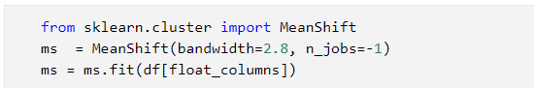
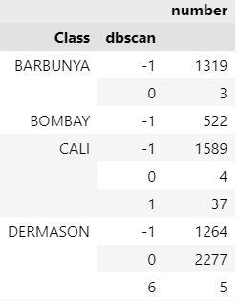
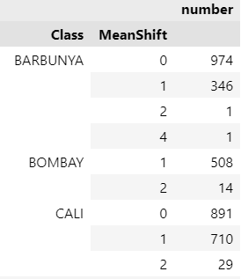
Machine Learning Analysis DBSCAN and MeanShift Algorithms
After applying these two algorithms many times with different parameters we got poor outcomes, where we validated the clustered observations with the actual classes, we got high error though the algorithm predicted the appropriate number of clusters

Slide 29
Machine Learning Findings algorithms comparison
As we mentioned in the previous slide DBSCAN and MeanShift achieved poor results in terms of observations clustering so will be excluded from the comparison and we will compare only between K-means and Agglomerative Clustering Algorithm
Class Label | Correct Clustering Percentage K-means | Correct Clustering Percentage Agglomerative
BARBUNYA | 88.96 % | 96.30 %
DERMASON | 77.13 % | 83.73 %
HORZO | 86.10 % | 83.09 %
CALI | 16.44 % | 0.37 %
BOMBAY | 99.17 % | 100 %
SIRA | 91.88 % | 85.43 %
SEKER | 92.60 % | 92.70 %
Overall Accuracy | 92.05 % | 90.03 %
Both clustering methods achieved great
Overall accuracy but at the end will choose the best model one which is K-means with overall accuracy = 92.05%.

Slide 30
Models flaws and strengths and advanced steps

Slide 31
Models flaws and strengths
Models Flaws and Strength:
K-means and agglomerative hierarchical clustering methods both were fast and accurate in terms of finding the appropriate number of clusters in addition of that they clustered most majority of bean observations correctly except one class which was CALI due to its characteristic's similarity with BARBUNYA class but in overall both algorithms achieved above 90 % in terms of clustering accuracy.
In contrast, DBSCAN and MeanShift required a lot of time to find the appropriate number of clusters since they identify the number of clusters dependably on the parameters that we need to change again and again to find the expected number of clusters furthermore, the outcomes of the observations clustering were so poor.

Slide 32
Advanced steps further suggestions:
To enhance the detection of CALI cluster in K-means and AHC models we can add another column represents the color of the bean to avoid the similarity issue with BARBUNYA
To enhance the clustering process in DBSCAN and MeanShift we can use beam images as data instead of geomatic characteristics of bean because both algorithms play very good roles in computer vision applications or we can use grid search and hyperparameters tuning to find the best parameters, but this will require a lot of time especially with MeanShift model

Slide 33
Thank you
IBM Machine Learning Professional Certificate
Unsupervised Machine Learning
By: Mohamad Osman

